Slide 1

Ceramics
Dr. J. Venkatramani
219-B
venkatramani@iiitdm.ac.in

Slide 2
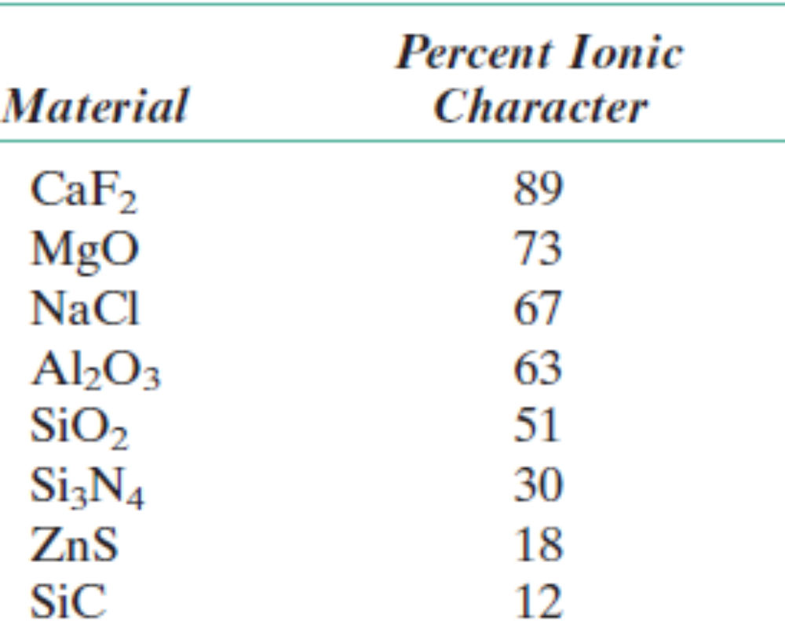
Ceramics
Inorganic and non – metallic
Compounds between metallic and non – metallic elements; ionic bonding or covalent bonding.
Name derived from the Greek word “keeramikos” meaning burnt stuff. Polymer derived Ceramics are one of the recent examples indicating this meaning.
X_{A} and X_{B} are electronegativities.

Slide 3
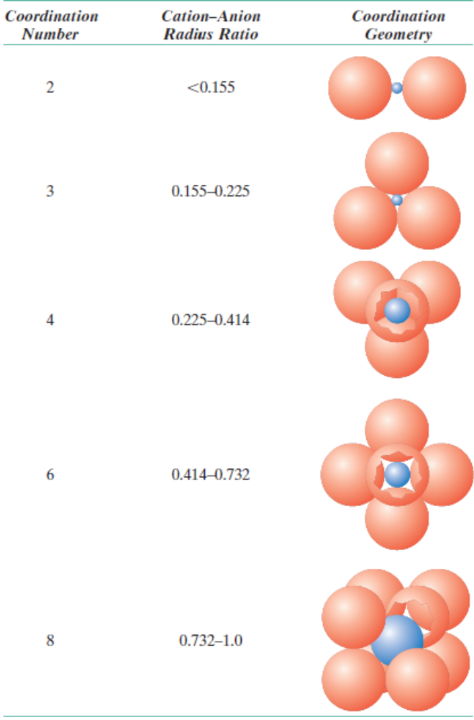
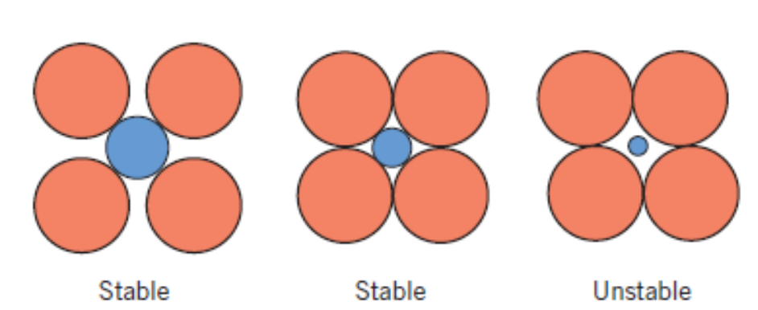
Ceramic – Crystal structures
For ionic ceramics, crystal structures depend on
the magnitude of electrical charge on each ion
Size of the ions – Cations are smaller than Anions.

Slide 4
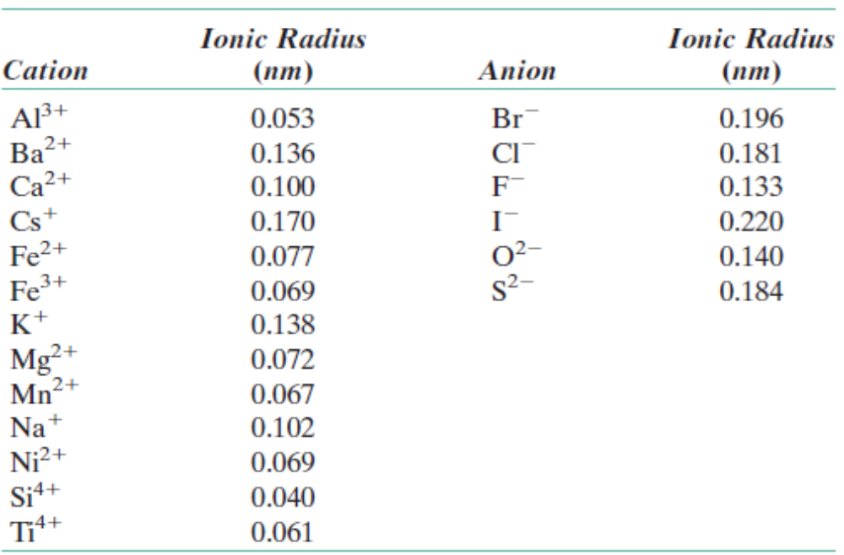
Ceramic – Crystal structures
For ionic ceramics, crystal structures depend on
the magnitude of electrical charge on each ion
Size of the ions – Cations are smaller than Anions.
Ionic Radii for Several Cations and Anions
(for a Coordination Number of 6)

Slide 5
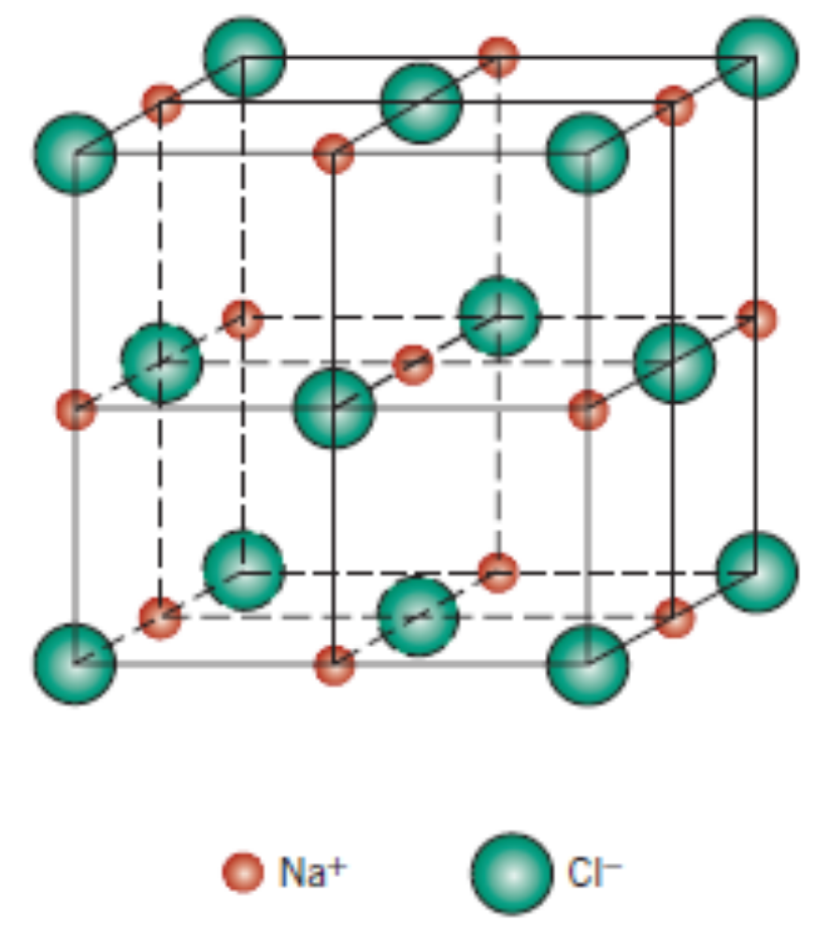
AX Type Crystal structures
NaCl – Rock Salt:
Co–ordination number = 6

Slide 6
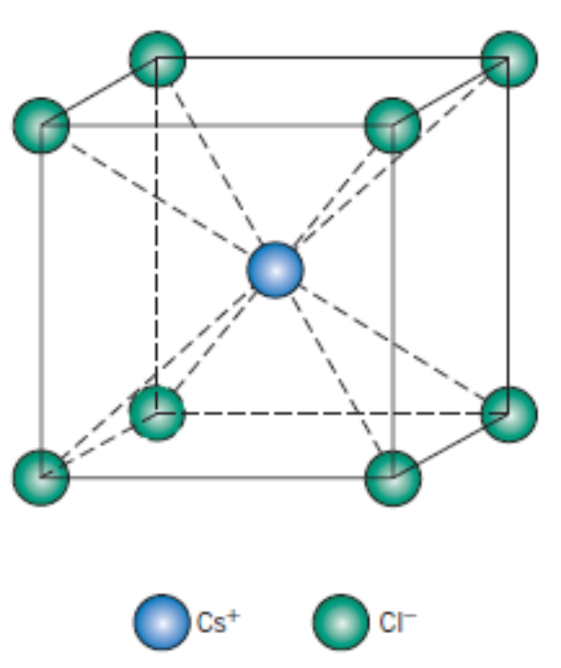
AX Type Crystal structures
Cesium Chloride
Co–ordination number = 8

Slide 7
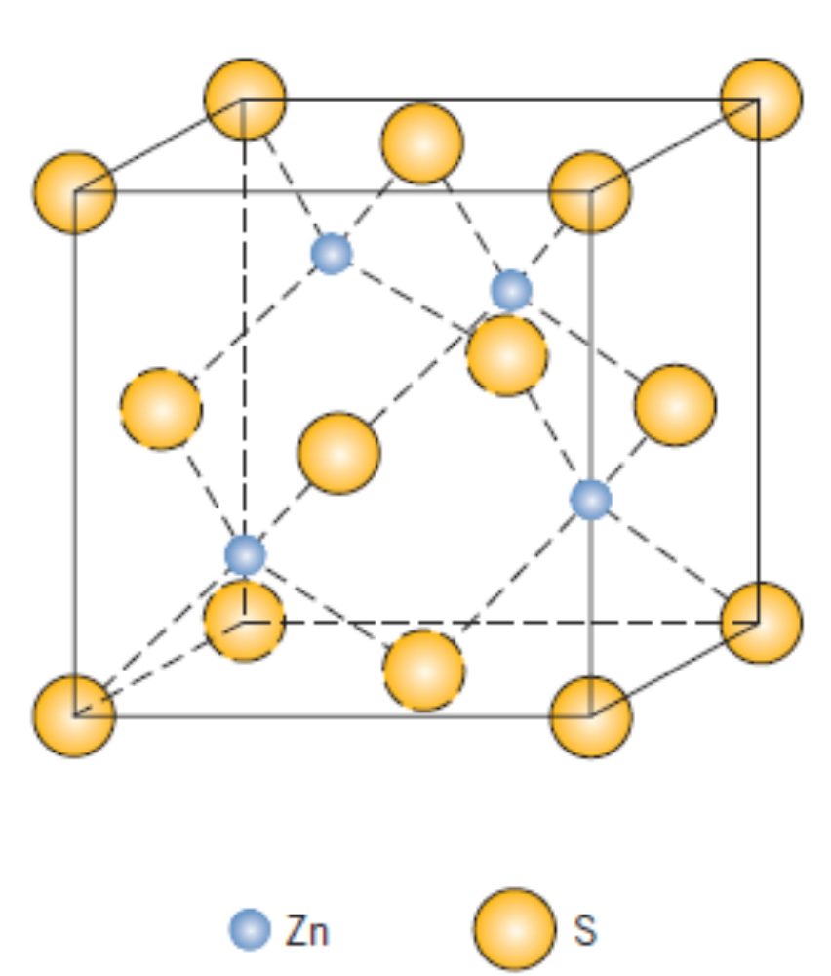
AX Type Crystal structures
Zn – Blende Structure (ZnS) or Sphalerite
Co – ordination number = 4
S atoms at the corner and face centers, while, Zn occupies interior tetrahedral positions.

Slide 8
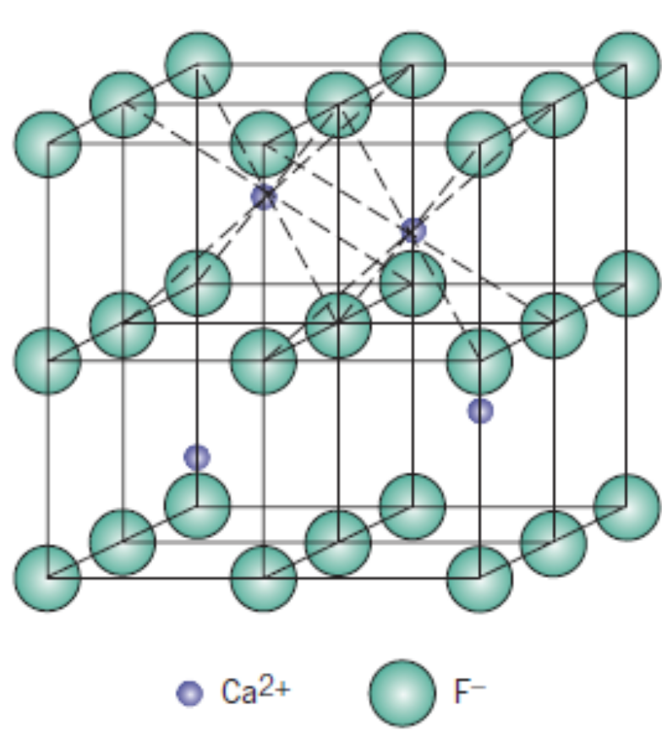
A_{m}X_{p} Type Crystal structures
Eg: CaF₂
Co – ordination number = 8

Slide 9
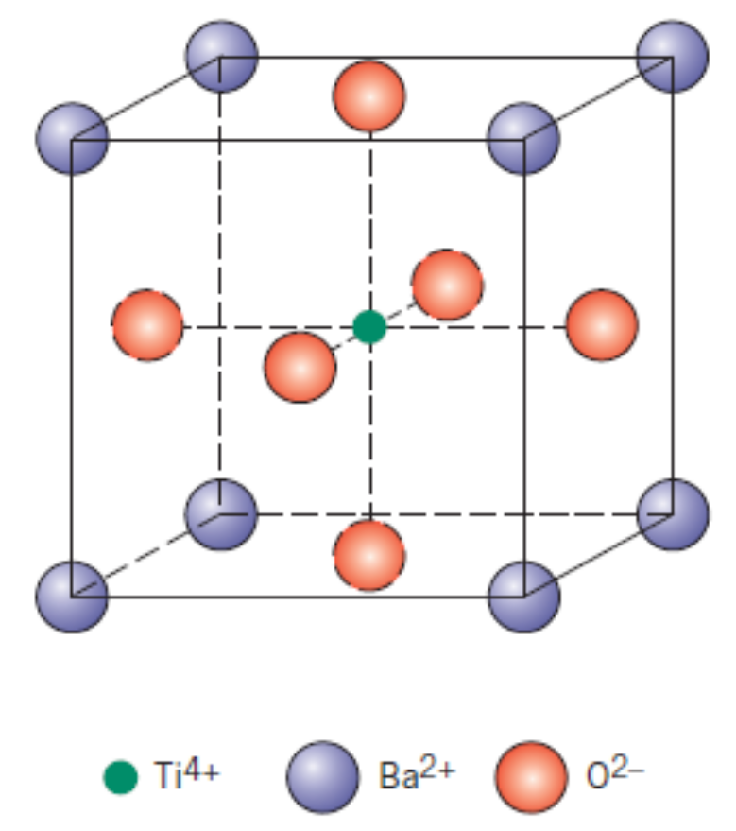
A_{m}B_{n}X_{p} Type Crystal structures
Eg: BaTiO₃
This crystal structure is called Perovskite type.
Has good electromechanical properties – suitable for applications in piezoelectric transducers.

Slide 10
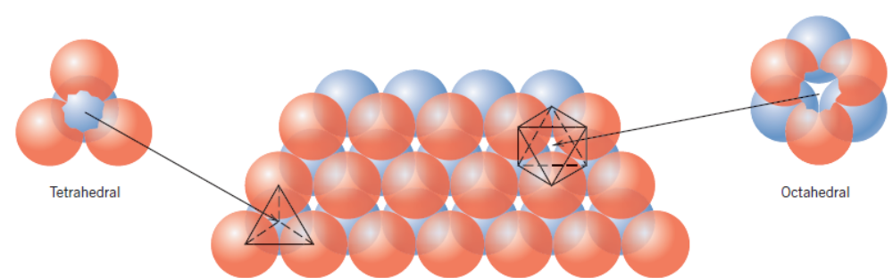
Close – Packed Planes of Anions
Similar to metals, Ceramic materials too have close packed planes and stacking sequence.

Slide 11
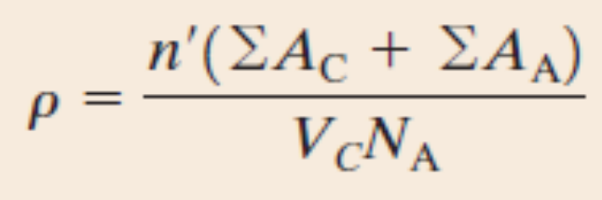
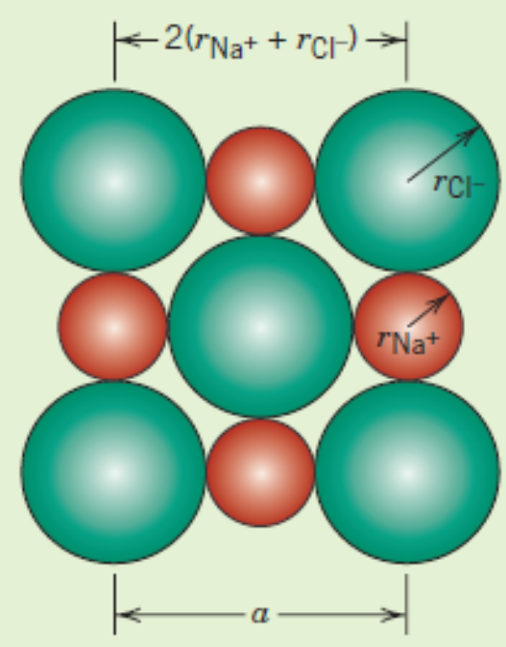
Theoretical density computation
Eg: NaCl. Required data: Atomic weights of Na and Cl are 22.99 g/mol and 35.45 g/mol. Radii of Na⁺ and Cl– are 0.102 nm and 0.181 nm, respectively.

Slide 12
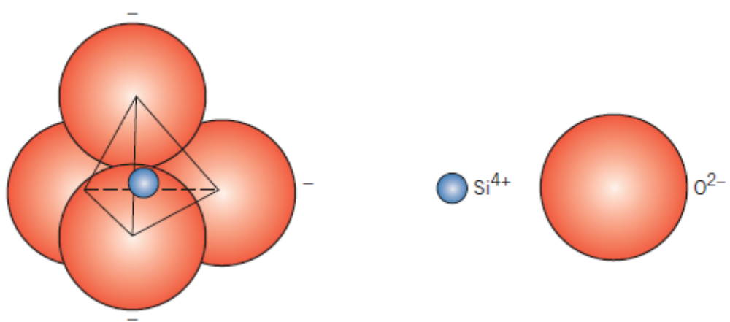
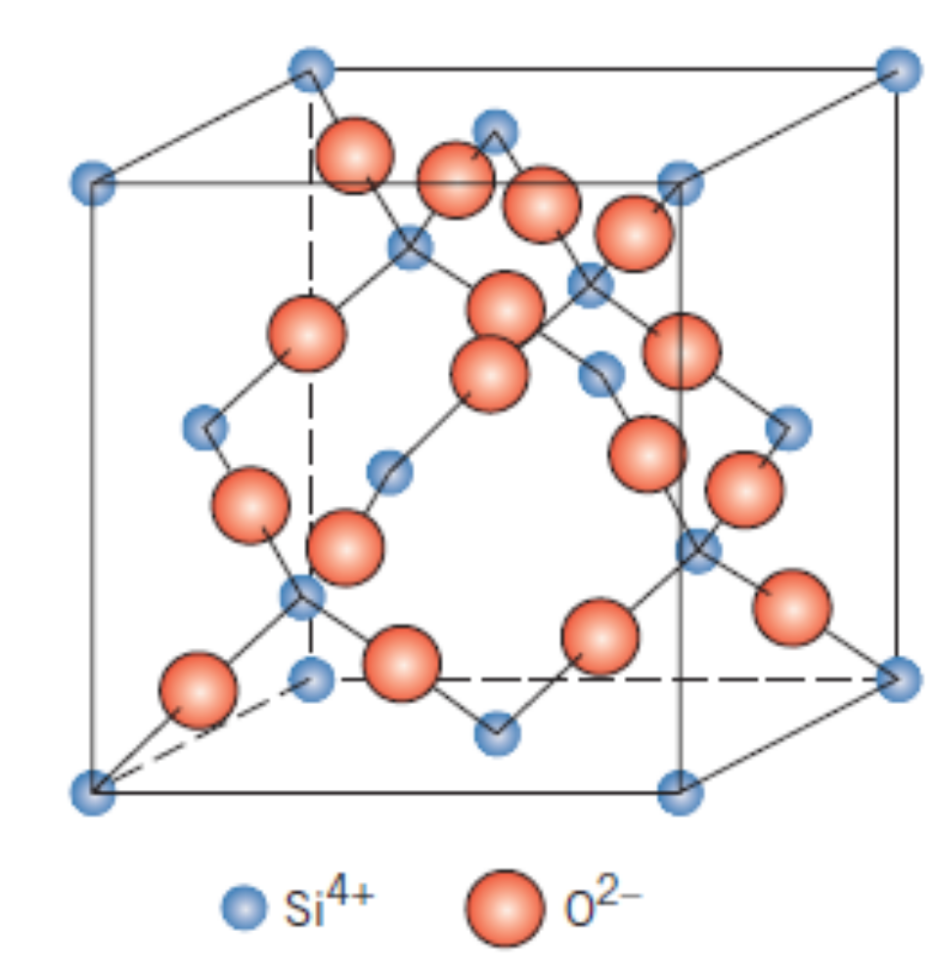
Silicate Ceramics
The fundamental unit of a silicate.
Crystalline Silica has three polymorphs:
Quartz, Cristobalite and tridymite.
Low density (2.65 g/cc) and high melting point: 1710⁰C.
Structure of Cristobalite: a Crystalline polymorph of Silica

Slide 13
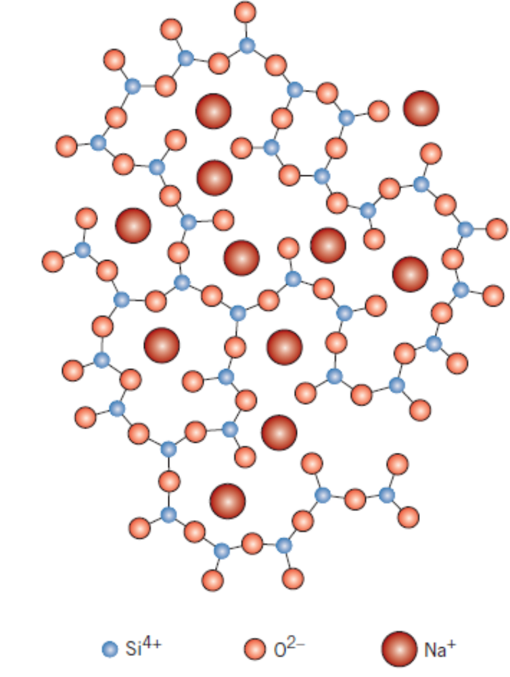
Silicate Ceramics – Silica Glasses
Fused silica or vitreous silica – they are called network formers.
Used for containers, windows.
Sodium–Silicate Glass

Slide 14
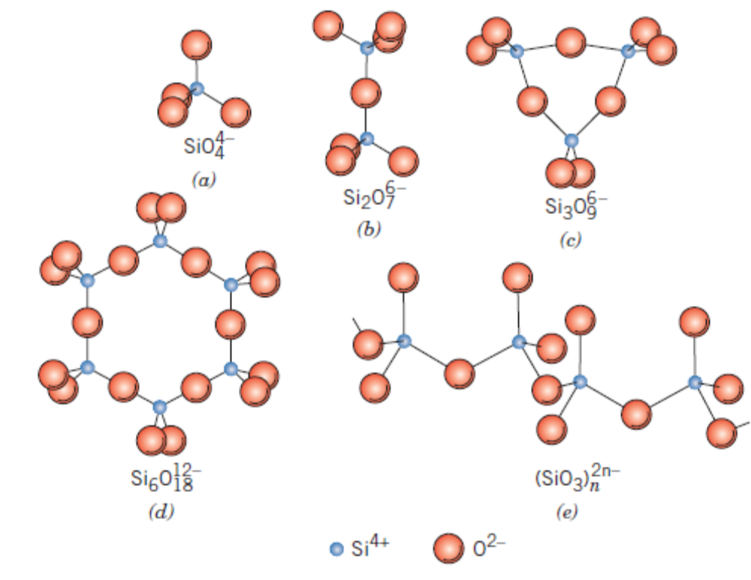
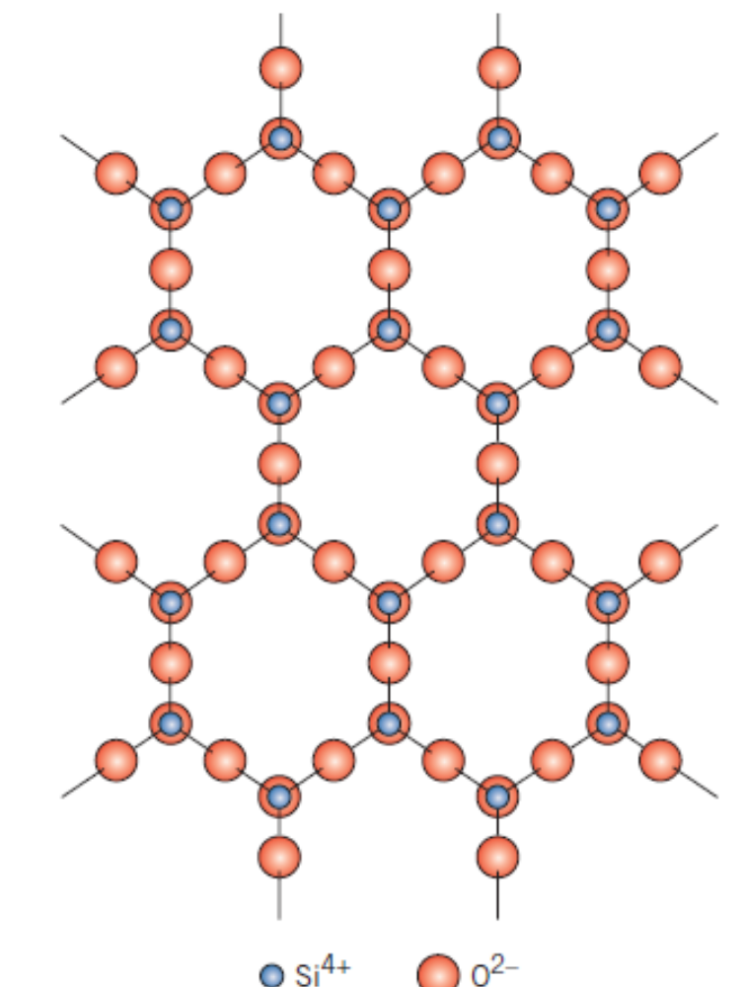
Silicate Ceramics – Other Silicates
Other Silicates:

Slide 15
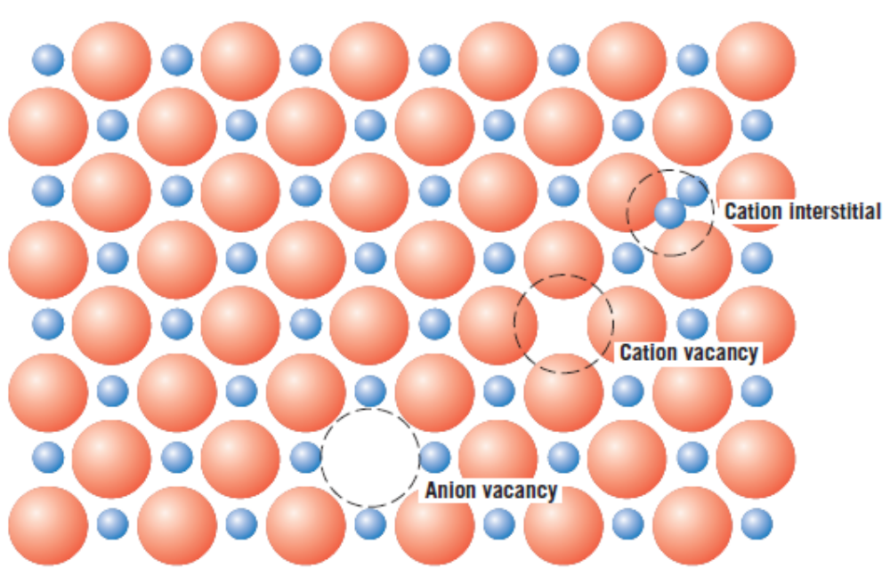
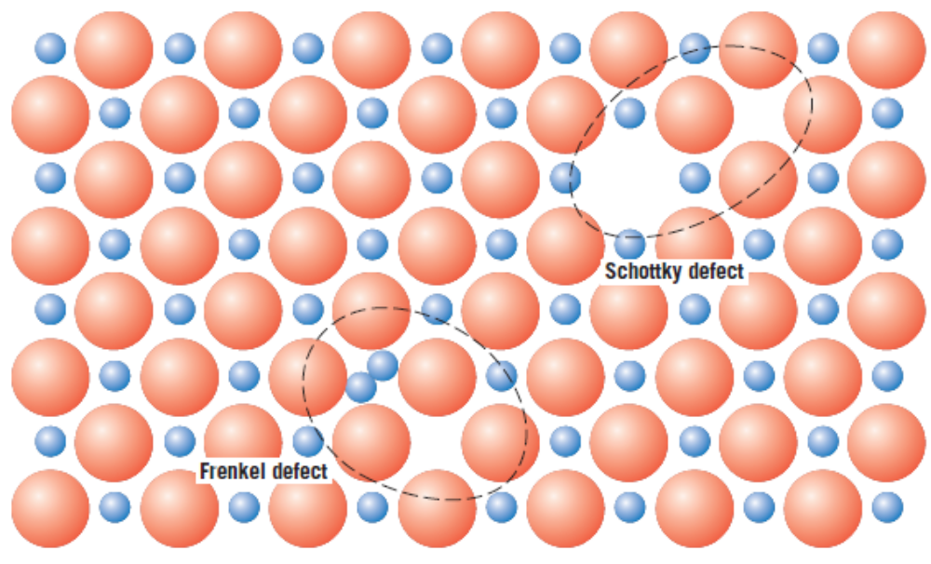
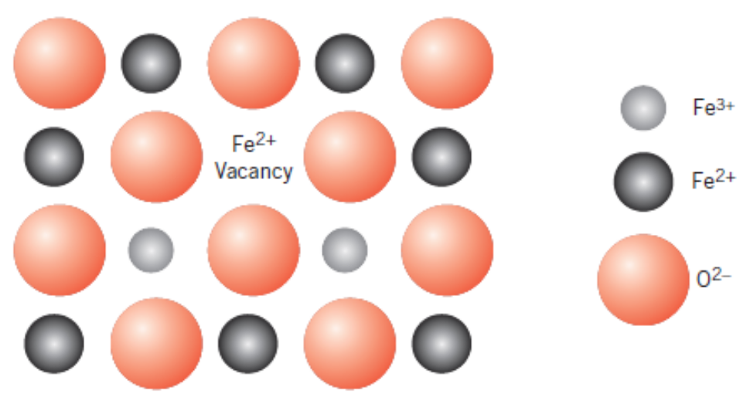
Imperfections in Ceramics

Slide 16
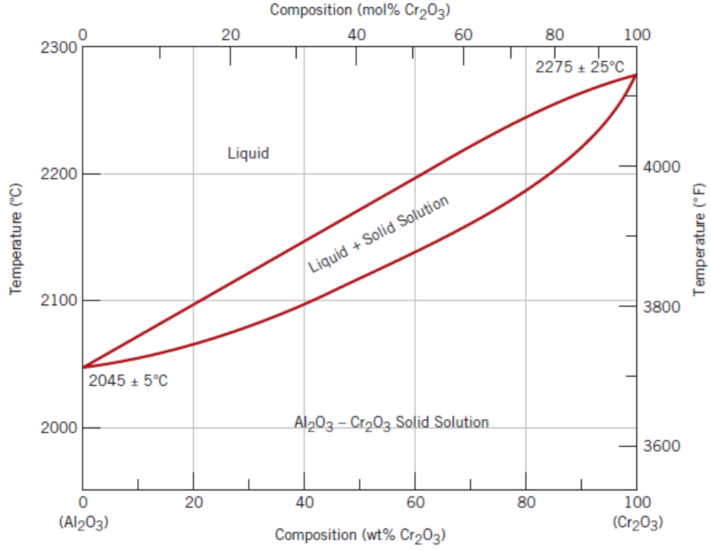
Ceramic Phase Diagrams – Al₂O₃–Cr₂O₃
A binary phase diagram

Slide 17
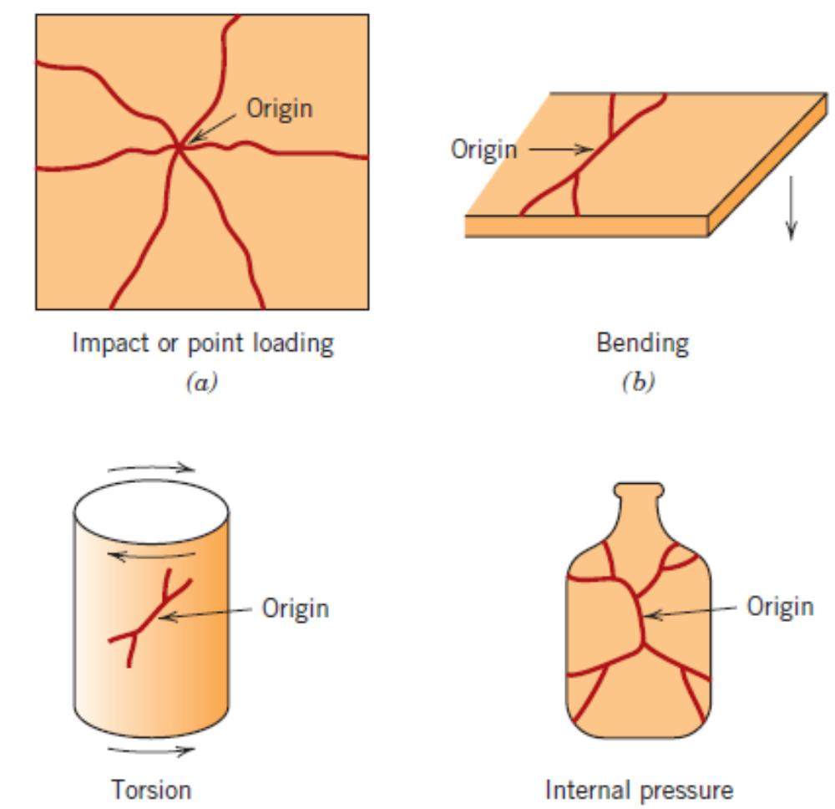
Mechanical Properties
Brittle Fracture of Ceramics

Slide 18
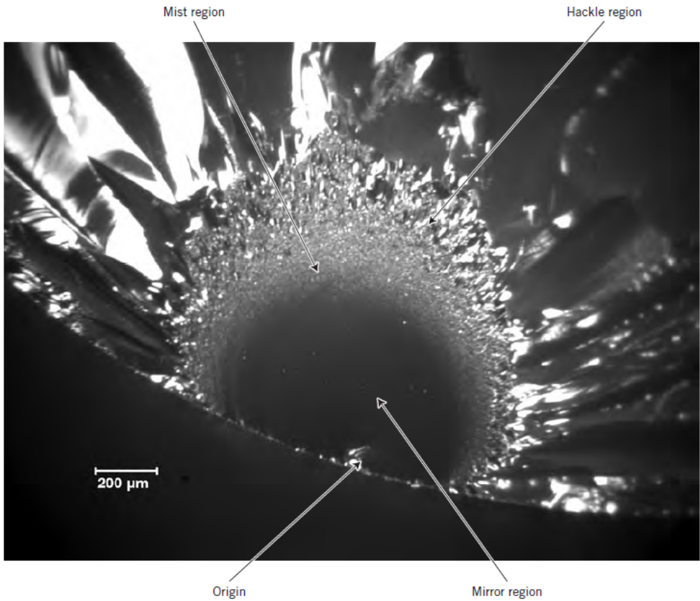
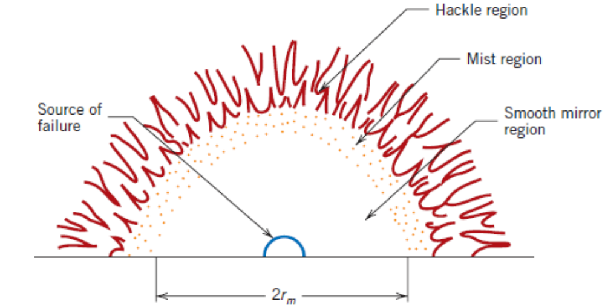
Mechanical Properties
Brittle Fracture of Ceramics

Slide 19
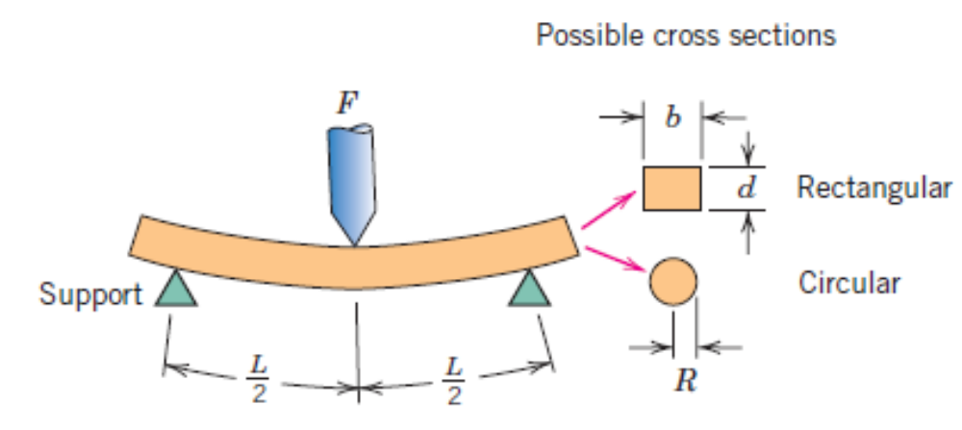
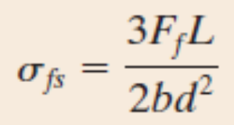
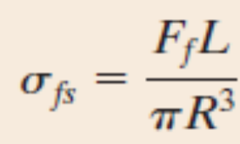
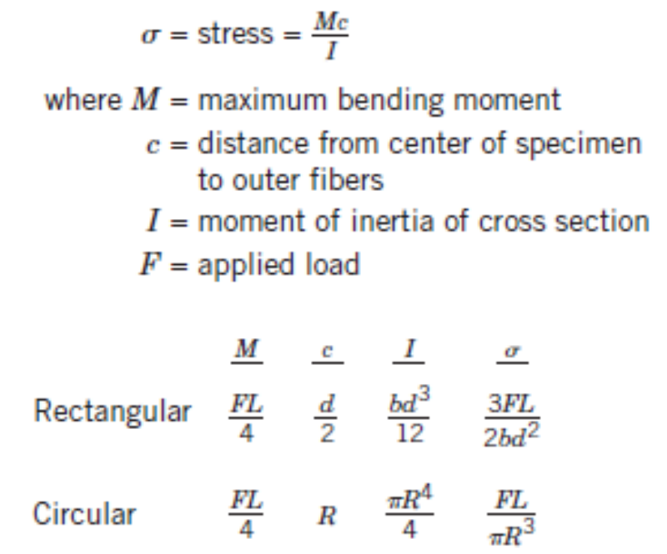
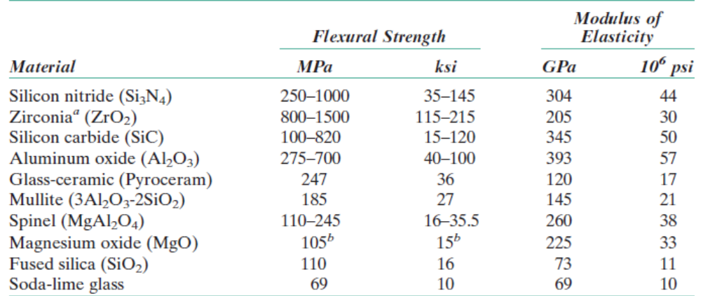
Stress – Strain Behaviour of Ceramics
Flexural test

Slide 20
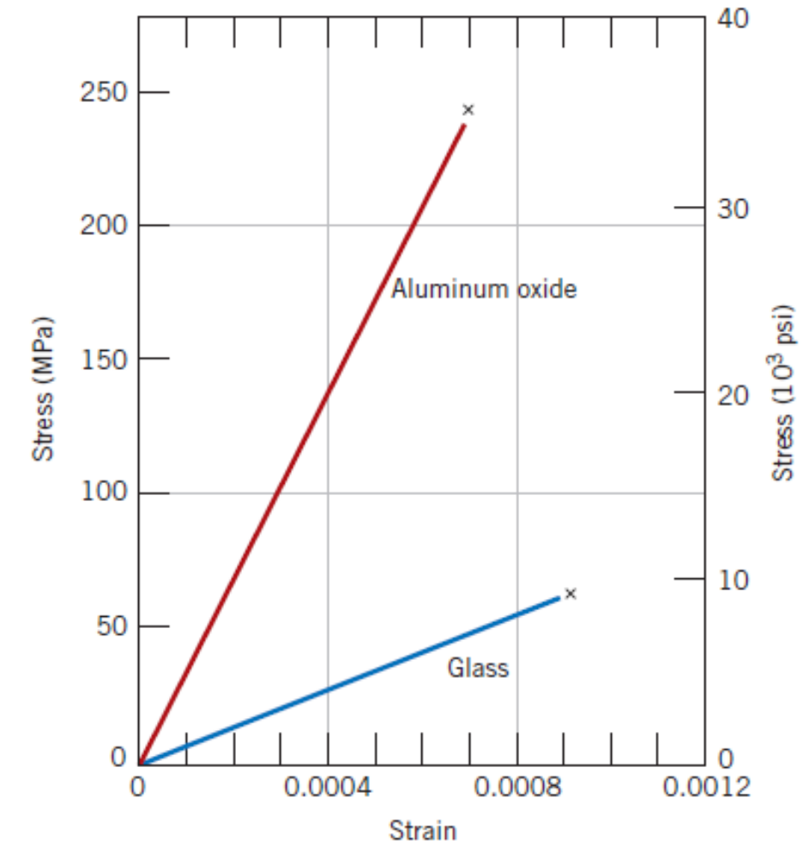
Stress – Strain Behaviour of Ceramics

Slide 21
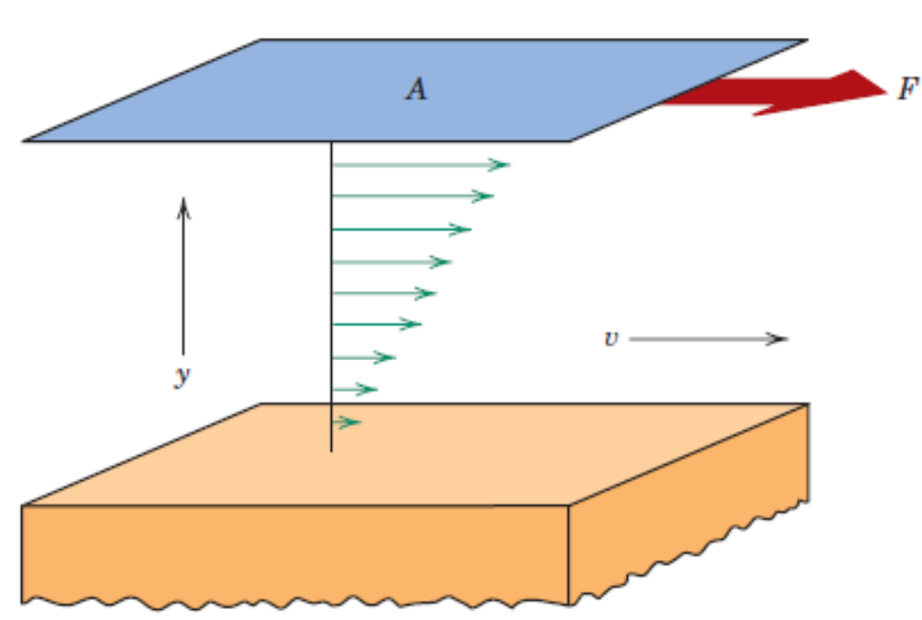
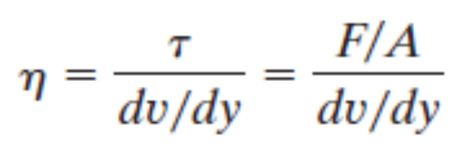
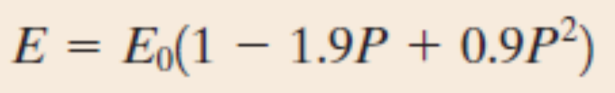
Mechanisms of Plastic Deformation
Crystalline Ceramics display certain amount of plasticity caused by dislocation motion, although the order of plastic strains are quite negligible.
Non – crystalline ceramics undergo plastic deformation in the form of viscous flow.
For porous ceramics,

Slide 22
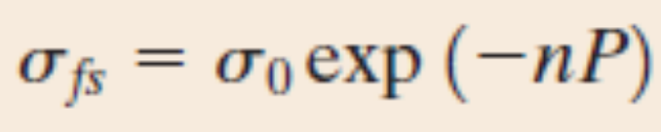
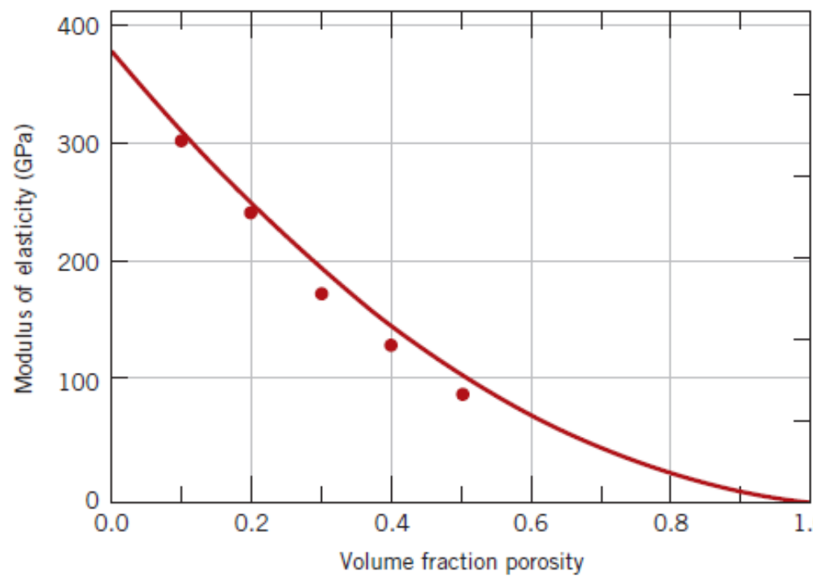
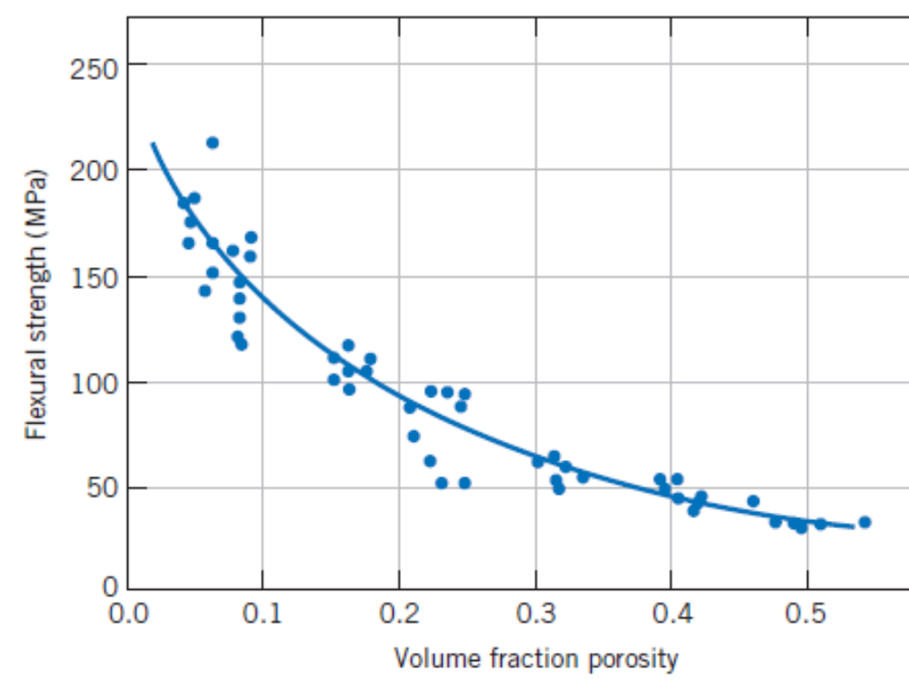
Porous Ceramics
For porous ceramics,

Slide 23
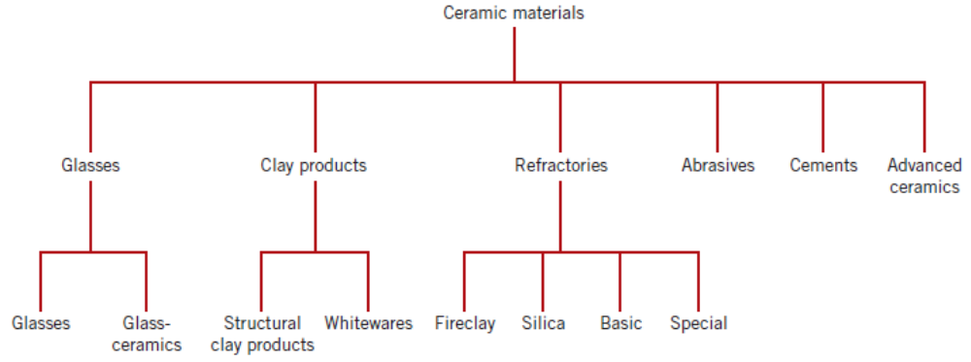
Ceramics – Classification

Slide 24
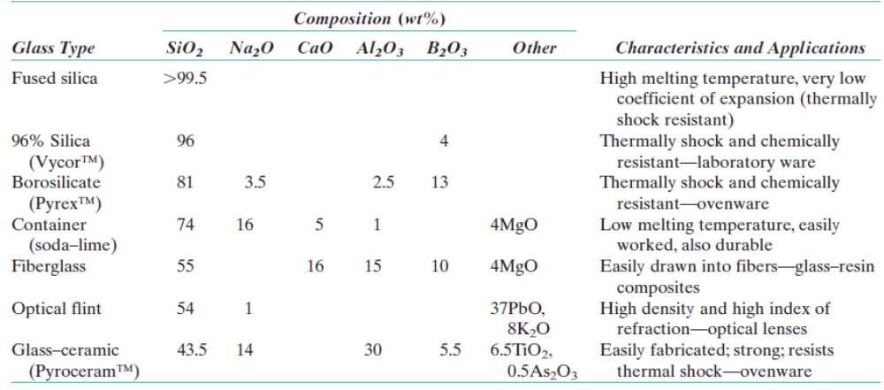
Glasses
CaO, Na₂O, K₂O and Al₂O₃ are known materials used for glasses, containers, windows, lens, fiberglass etc.

Slide 25
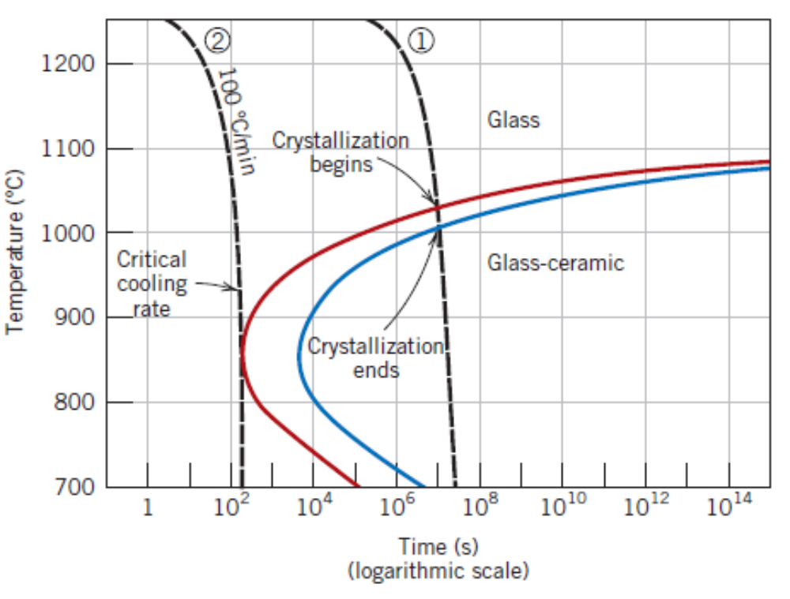
Glass Ceramics

Slide 26
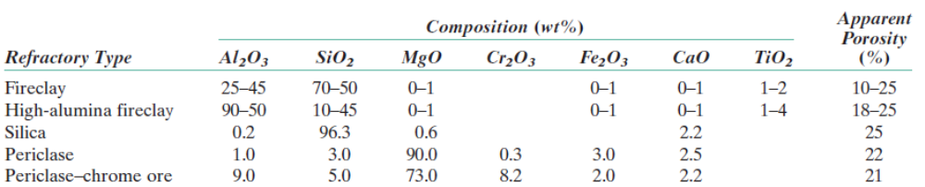
Clay and Refractory Ceramics
Clay ceramics are of two types – Structural and Whiteware
Refractories are unreactive, inert to severe environments; can be used for thermal insulation due to high melting points

Slide 27
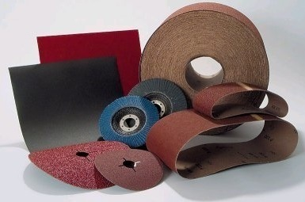
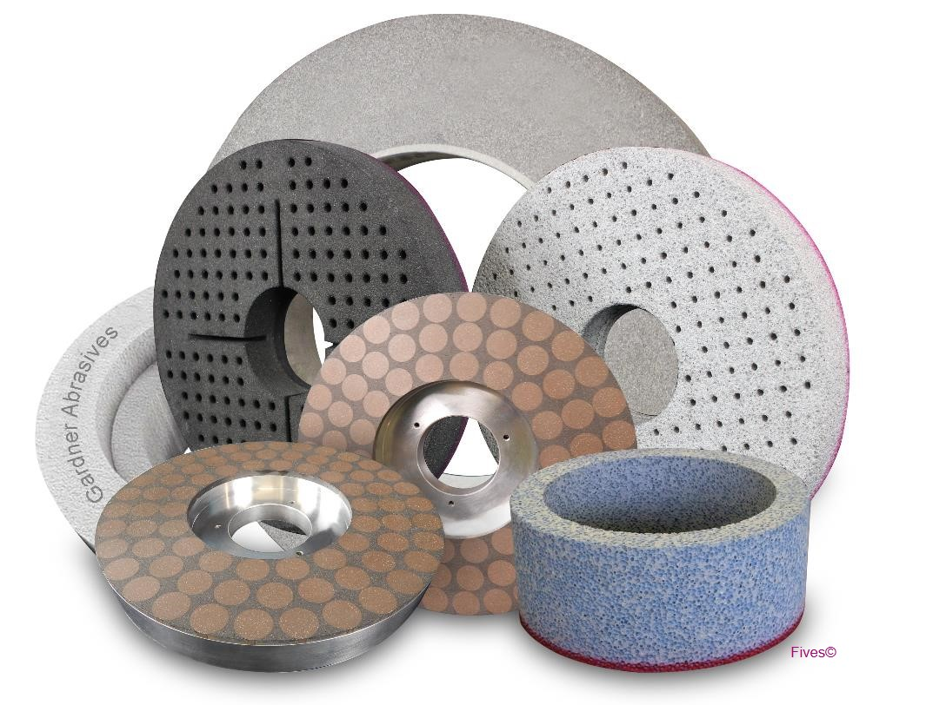
Abrasives

Slide 28
Cements
Cement, Plaster of Paris and lime.
Preparation of Portland Cement
Calcination
Clinker
Grinding and mixing of clay and lime bearing minerals
Heating up to 1400⁰C
The resulting powder is ground and gypsum is added to delay the setting process.
Portland Cement
Hydration Reaction

Slide 29
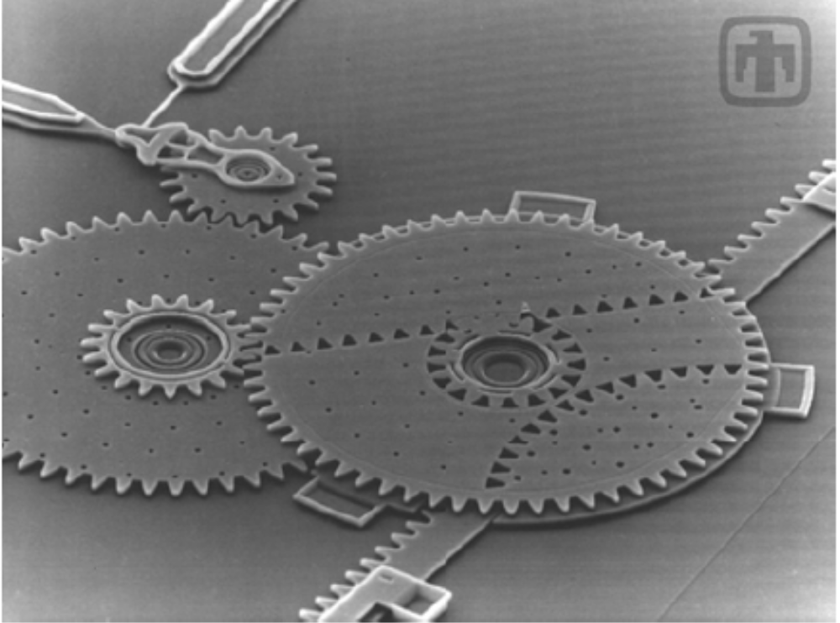
Advanced Ceramics
Micro–Electro Mechanical Systems (MEMS)
Various processing techniques such as photolithography, ion implantation, etching and deposition technologies are used. Micromachining techniques are also available to manufacture such miniaturized components. Silicon is the material currently under use.
Silicon carbonitrides are being considered to be used instead of Silicon alone.
Rack & Pinion Arrangement–miniaturization (Image @ 100X)

Slide 30
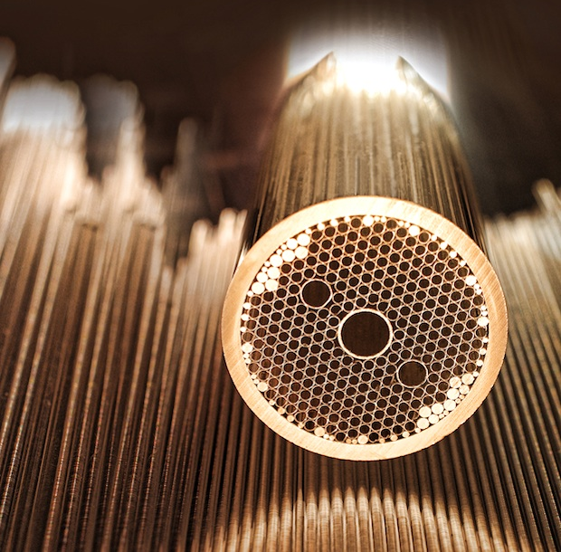
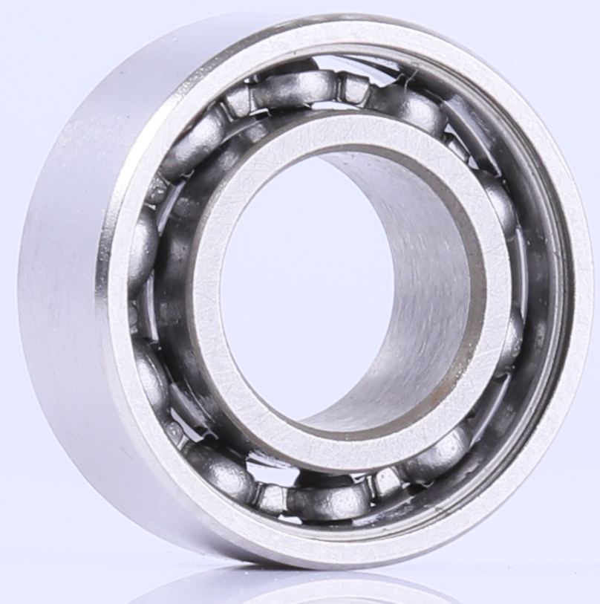
Advanced Ceramics
Optical Fibers are made of high purity silica.
Ceramic ball bearings are also in use now-a-days. Silicon Nitride is the material which is replacing steel.
Optical Fiber
Hybrid Ceramic ball bearing

Slide 31
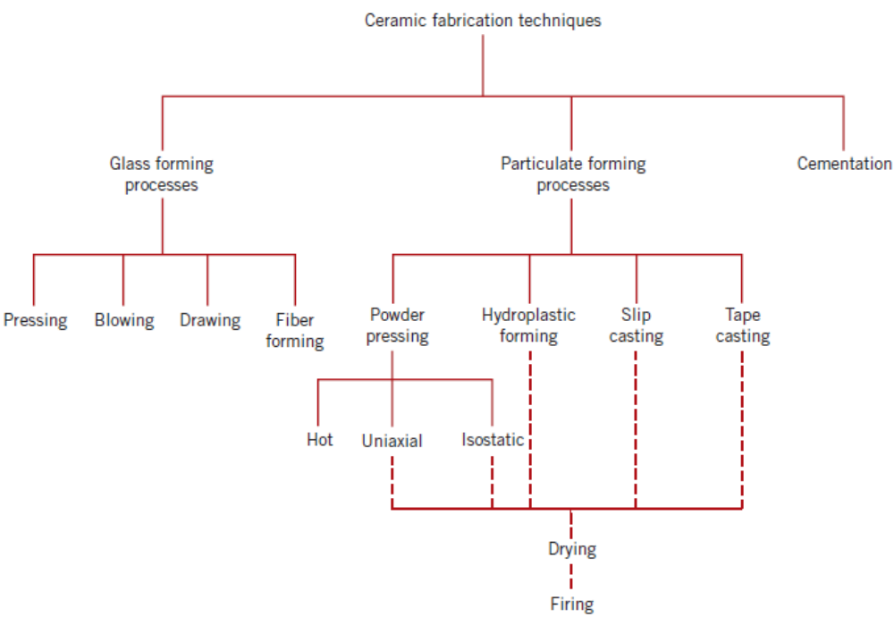
Fabrication and Processing of Ceramics
Can we adopt casting or other forming operations for processing Ceramics?

Slide 32
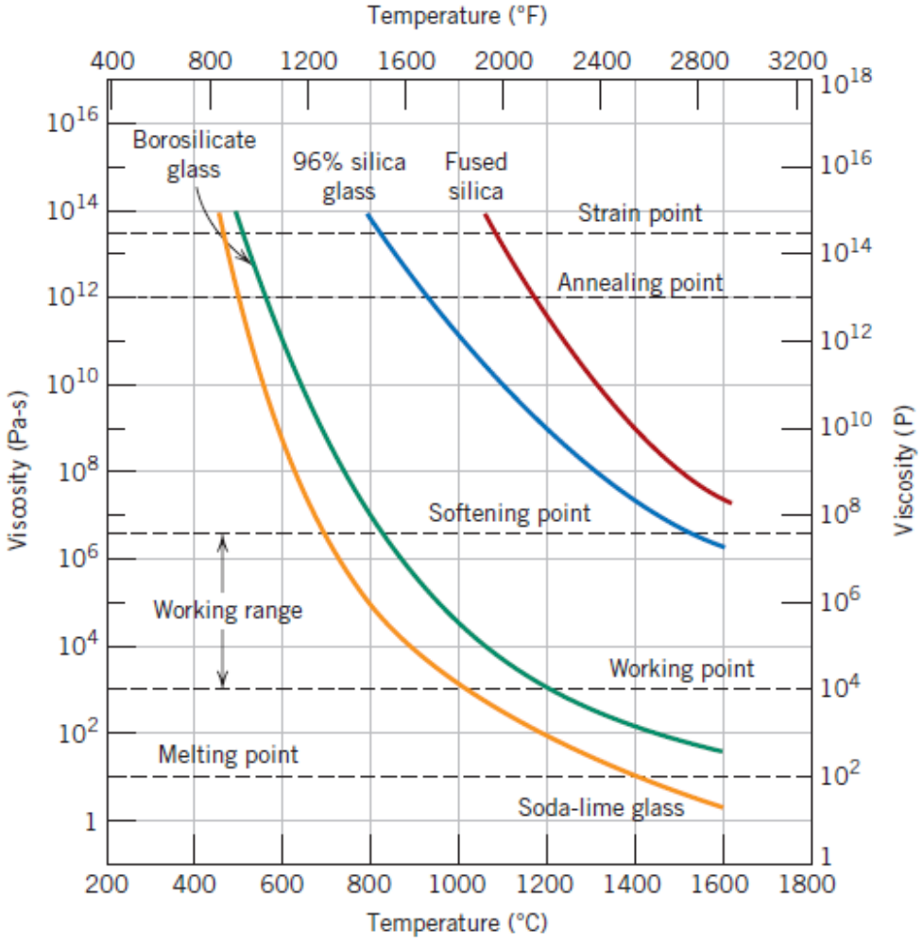
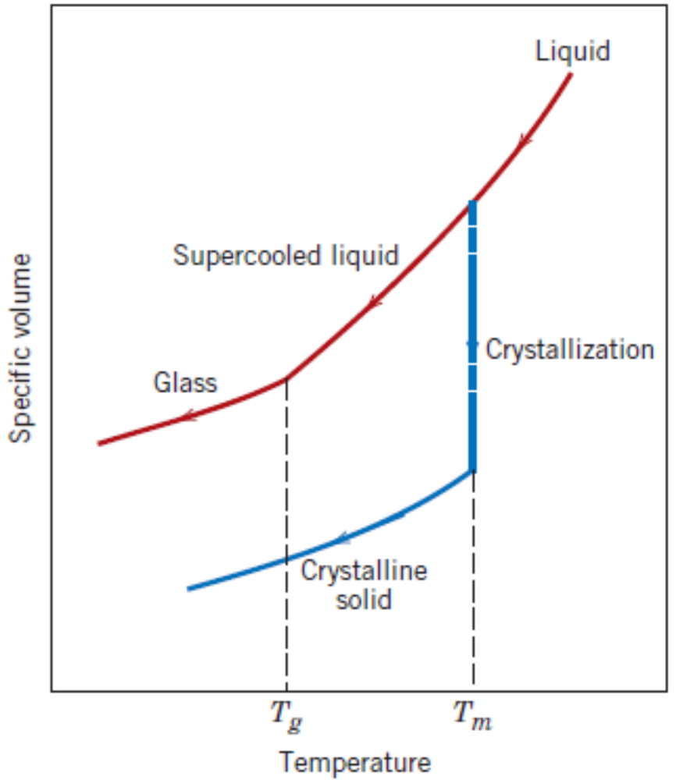
Glasses and Glass–Ceramics
Temperature sensitive behaviour of glassy or non – crystalline materials

Slide 33
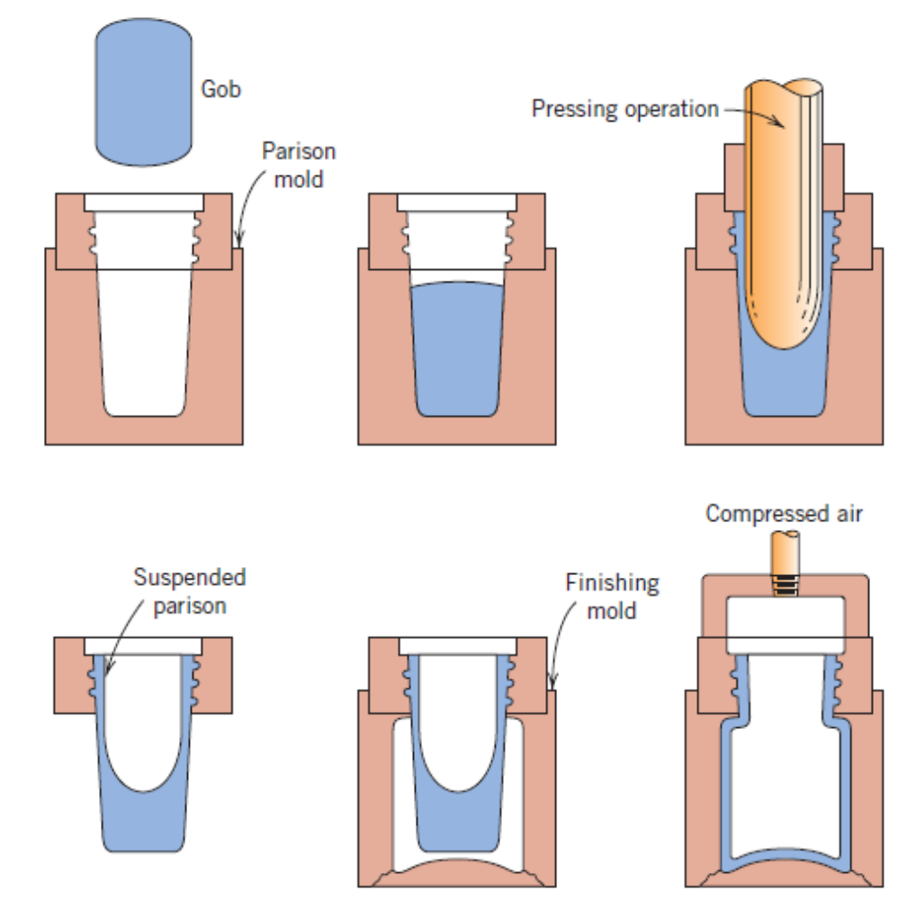
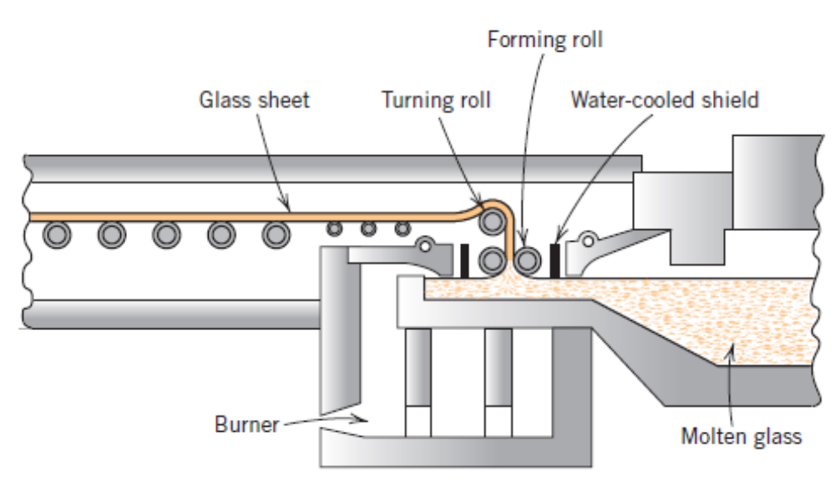
Glasses and Glass–Ceramics
Glass Forming
– Pressing, blowing, drawing and fiber forming
Glass Drawing
Glass Pressing & Blowing

Slide 34

Making of a sheet glass

Slide 35



Clay Products
Hydroplastic forming and Sand casting
Solid slip casting
Hydroplastic forming
Drain slip casting

Slide 36



Powder Pressing

Slide 37

Tape Casting

